Slide 1
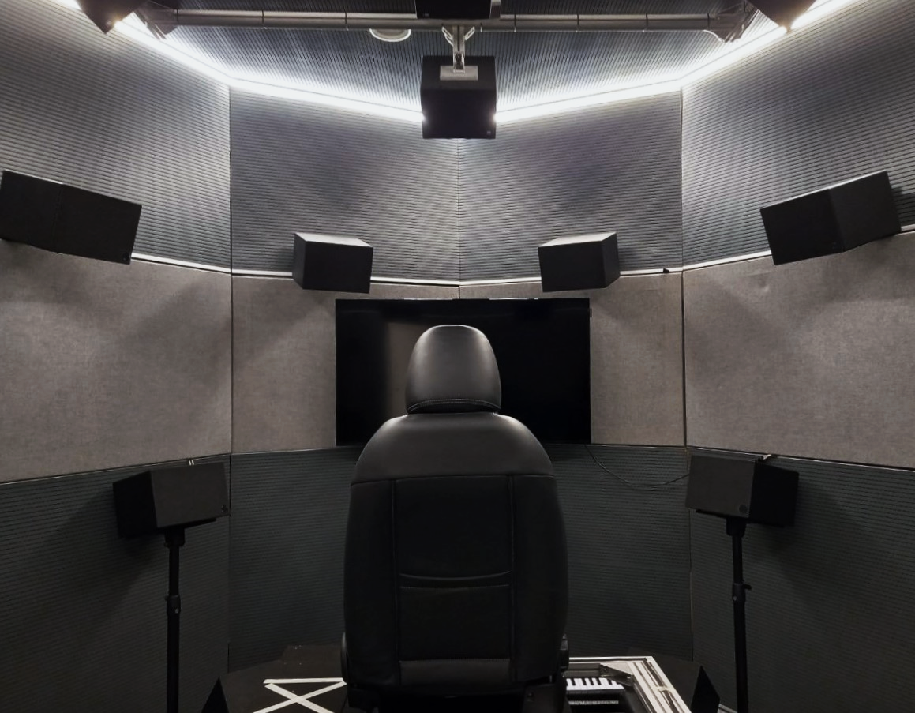


Characterization of an Ambisonics Reproduction Room
Master of Science Degree in Music and Acoustic Engineering
A. Y. 2022-2023
Advisor: Prof. Fabio Antonacci
Co-advisors: Enrico Zoboli, Dott. Mirco Pezzoli
Sofia Parrinelli
Student ID: 991735

Slide 2
Presentation outline
Introduction to Ambisonics surround system
Room acoustic analysis
Spherical harmonics assessment
Outcomes and considerations
Limits and future developments

Slide 3
Introduction
→ Goal:
definition of a method for Ambisonics reproduction site assessment
→ Steps:
Verify the room’s acoustical properties
Test two metrics for the spherical harmonics' reproduction assessment

Slide 4
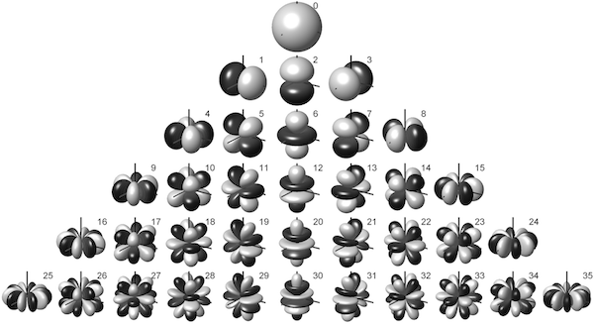
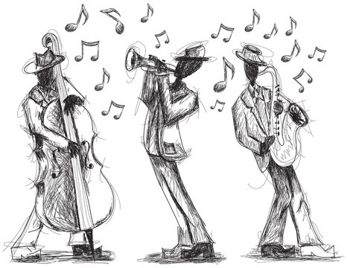
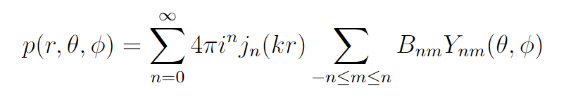
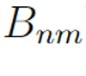
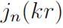
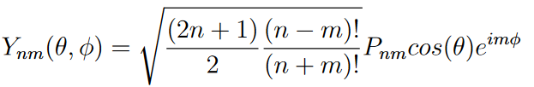
Ambisonics Theory
The sound field is discretized in a set of spherical harmonic functions:
Spherical harmonic coefficients
First kind Bessel function

Slide 5
Ambisonics: prerequisites for a surround system
Dry environment
Sweet spot
Proper speaker array layout
Limit reflection artifacts
Validity area
Homogeneous space discretization

Slide 6
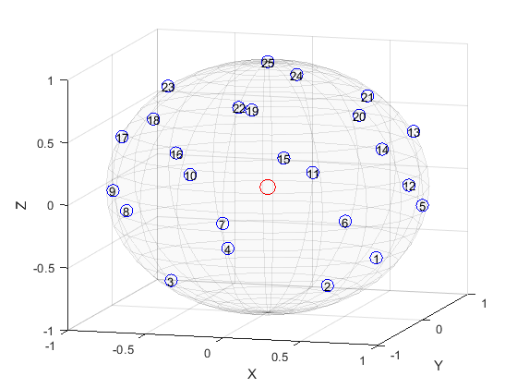
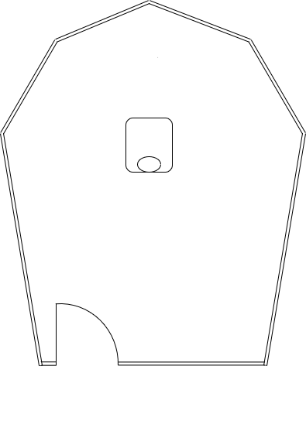
Study site
. 25 woofers
25 tweeters
2 subwoofers
Spherical speaker array layout
Non-parallel walls
Walls covered with sound-absorbing panels
The speaker array can reproduce up to 4th-order Ambisonics

Slide 7
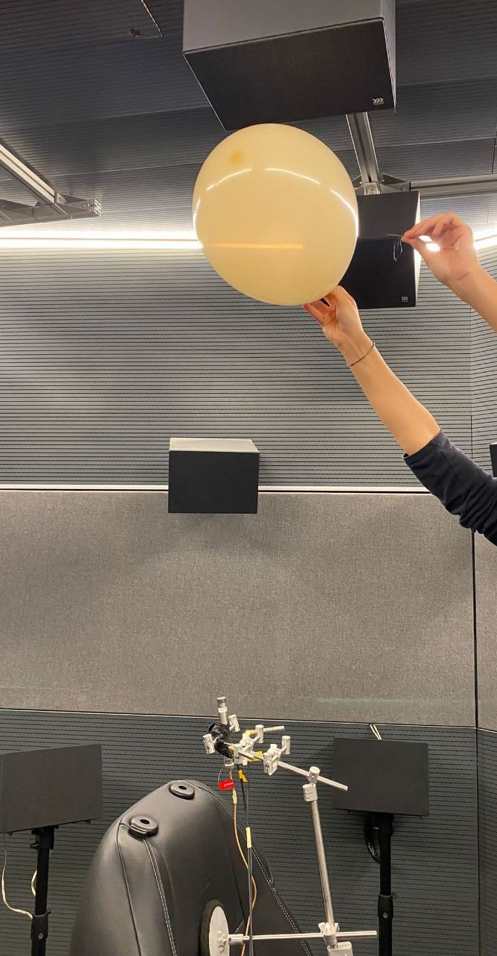
Room acoustic analysis
RIR extraction | Sinusoidal exponential sweep: RIR as the superposition of each speaker’s IR Balloon popping
Tested cases | Different room configurations seeking main reflection sources
Extracted parameters | T20 EDT C50

Slide 8
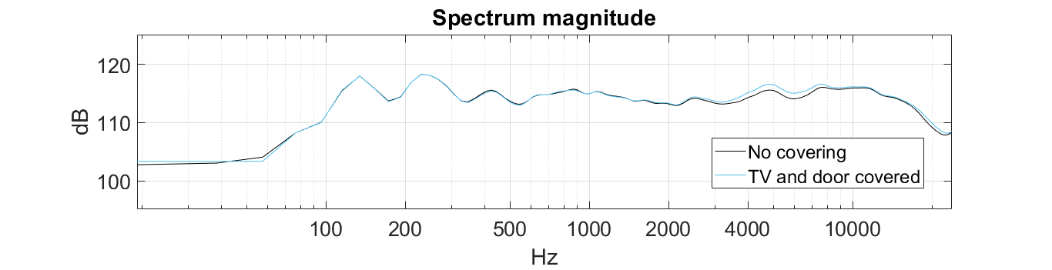
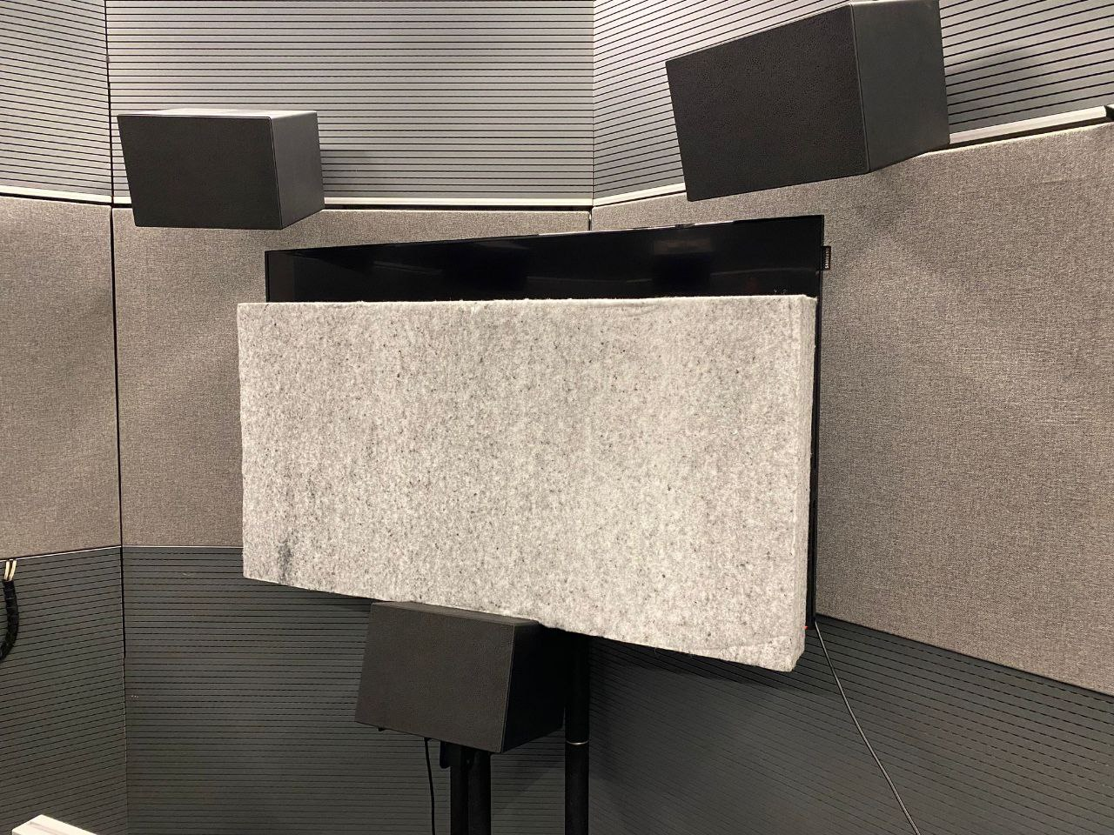
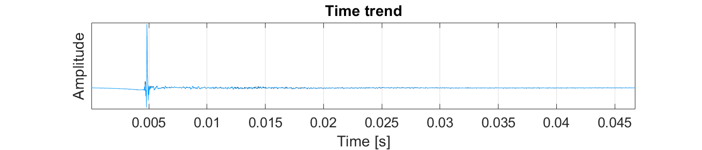
Room acoustic analysis: evaluations
Room configuration tests
?
Do not alter the room set-up

Slide 9

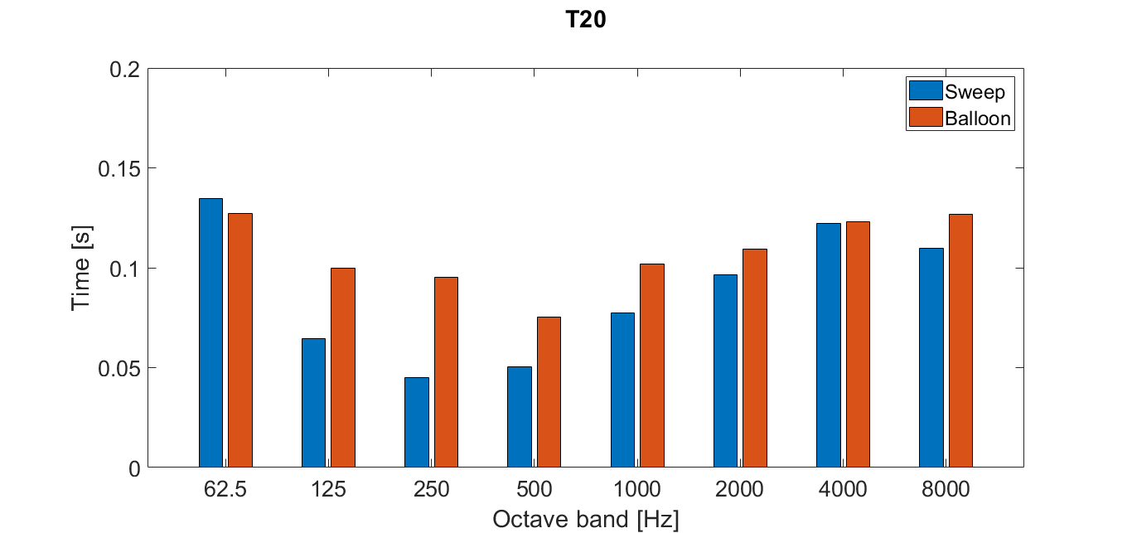
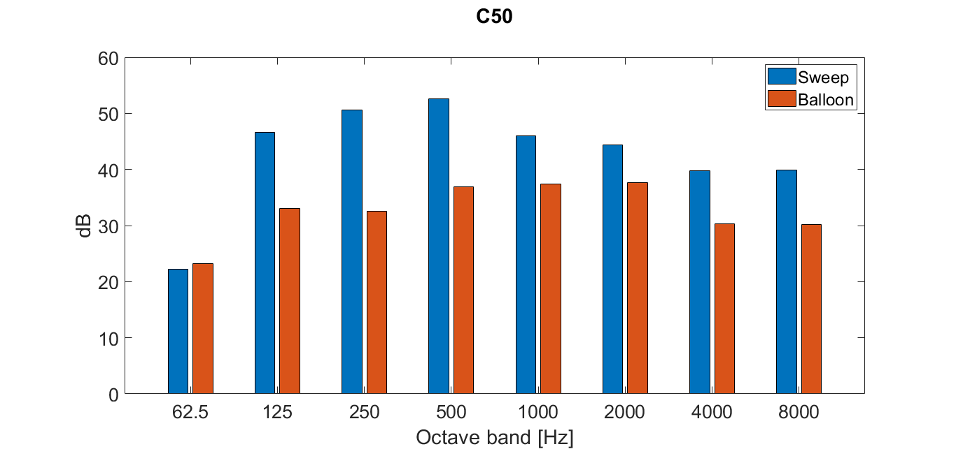
Room acoustic analysis: parameters
Semi-anechoic behaviour confirmed:
Subwoofer excitation
31 Hz octave band:
T20 | C50
0.2 s | 10 dB

Slide 10
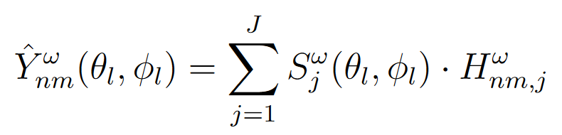
Spherical harmonics assessment metrics
Spatial Correlation
Level Difference
MEASURED SPHERICAL HARMONICS
CAPSULE
EIGENBEAM
MATRIX
Experimental for
playback system assessment
SIGNALS
Spatial Correlation | Level Difference
Similarity between: the generated patterns the ideal spherical harmonic patterns | Disparity between: the mean level across all directions→ total energy sum of the encoded response across all points the corresponding ideal components

Slide 11
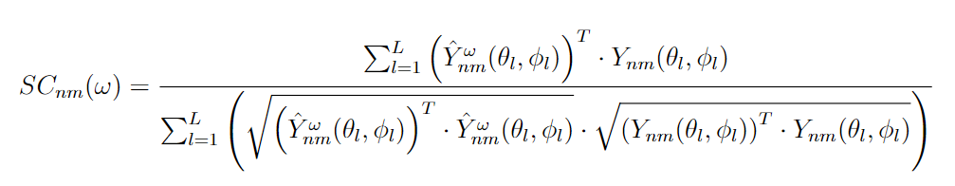
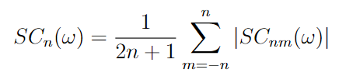
Spatial Correlation
Across all sources directions L:
Measured spherical harmonic
Ideal spherical harmonic
Mean across all degrees m for each order n:

Slide 12
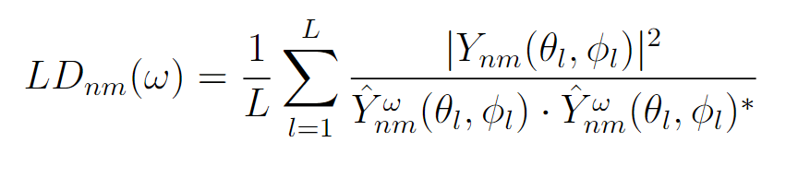
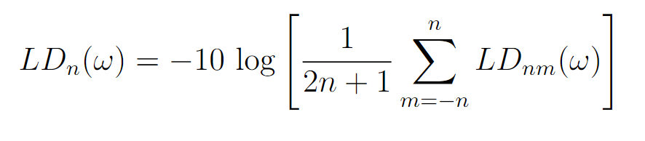
Level Difference
Mean across all sources directions L:
Ideal spherical harmonic
Measured spherical harmonic
Mean across all degrees m for each order n:

Slide 13
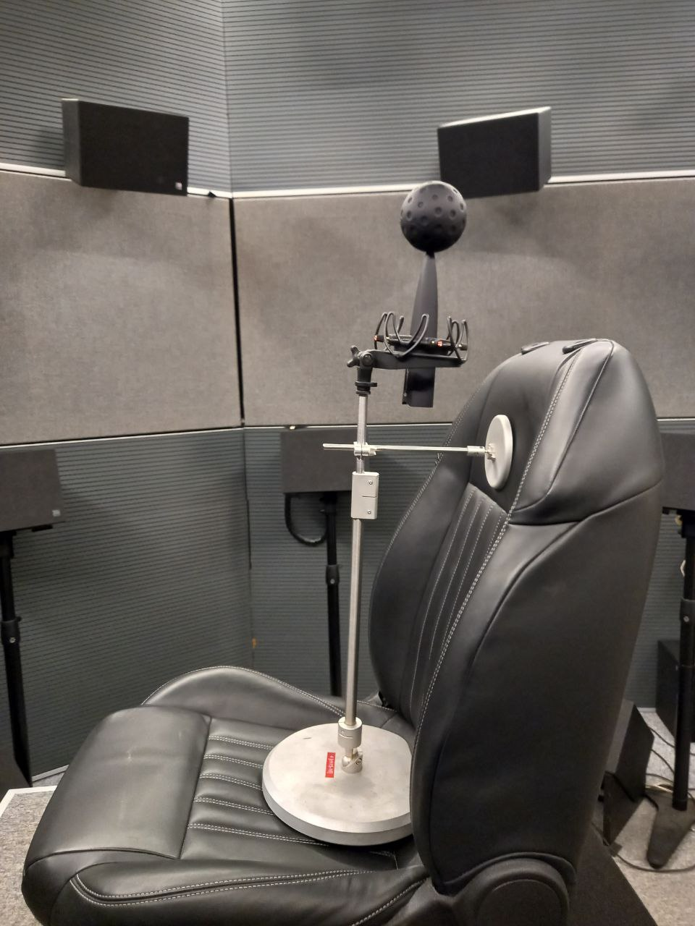
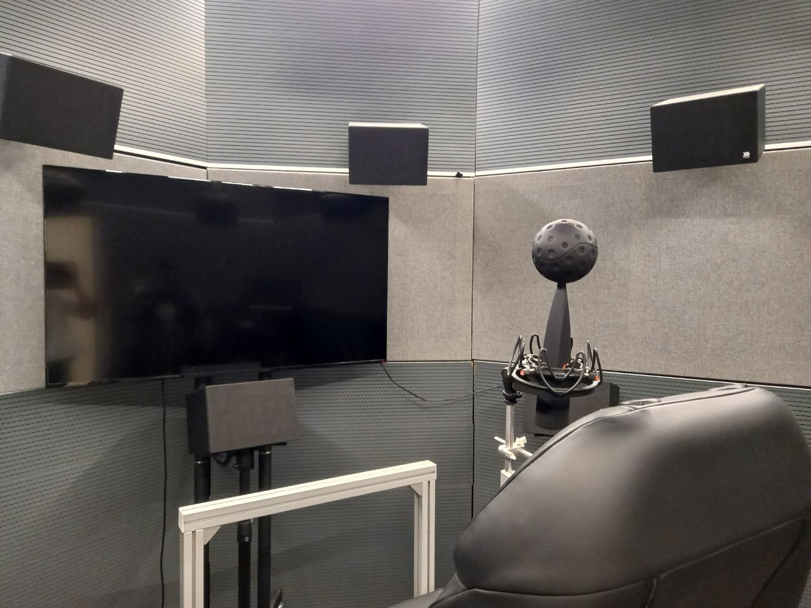
Metrics employement in case study
Eigenmike64® : idealization within each validity order’s range
Two tested measurement positions:
central, 40 cm left
Utilization of a proper equalization:
ATD alignment
Frequency correction

Slide 14
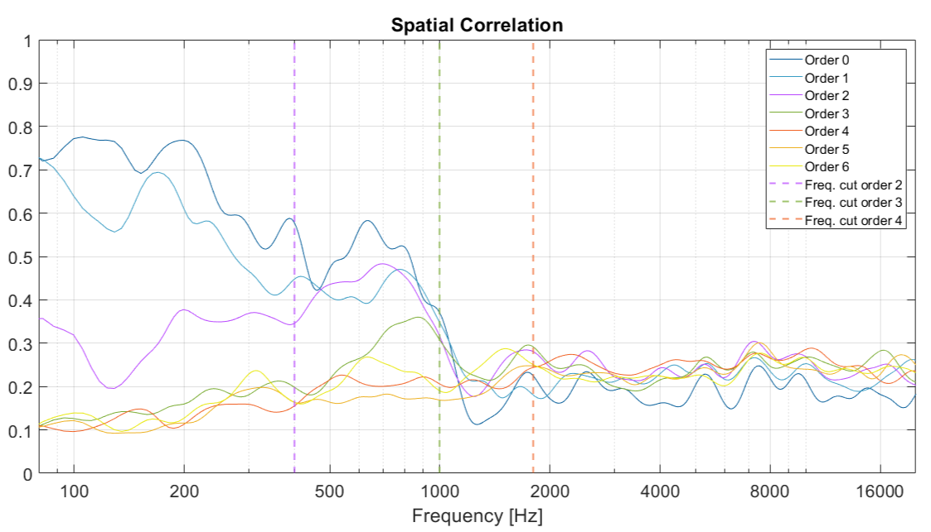
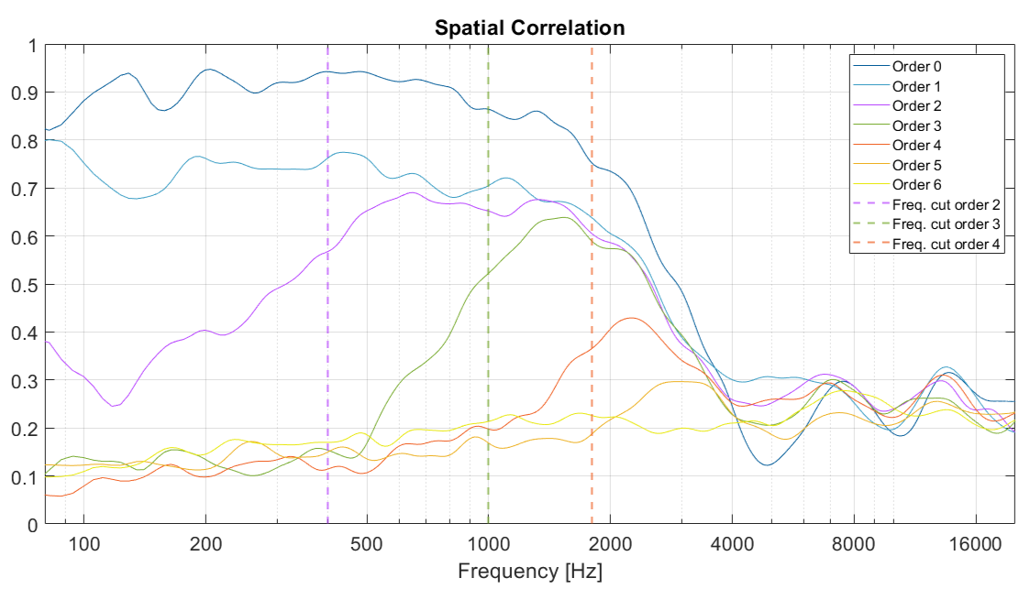
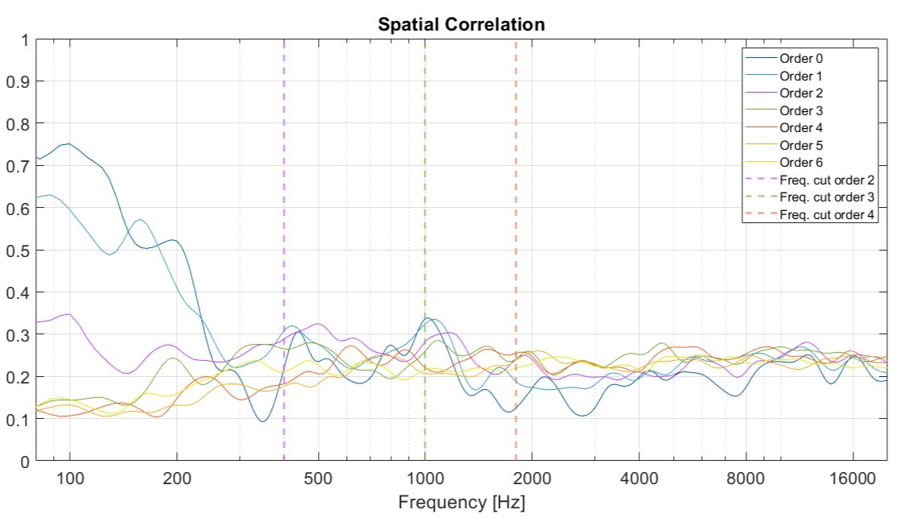
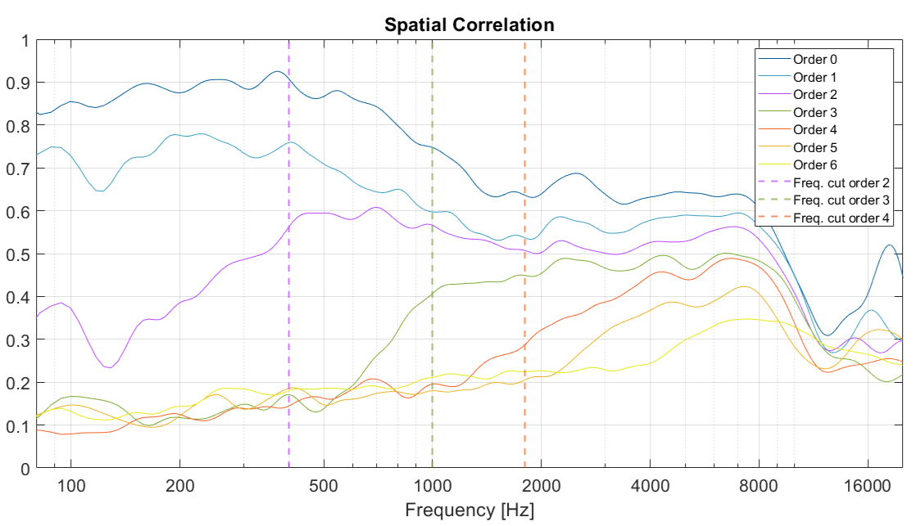
Not equalized
Equalized
Central
Left

Slide 15
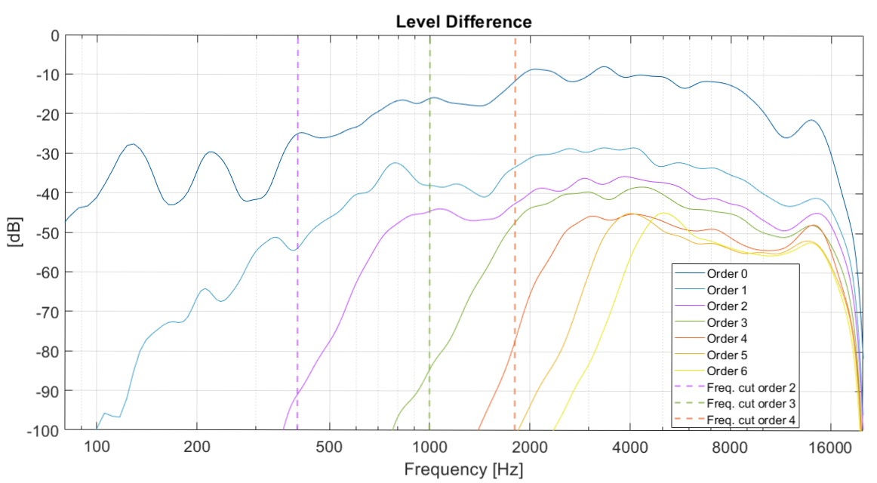
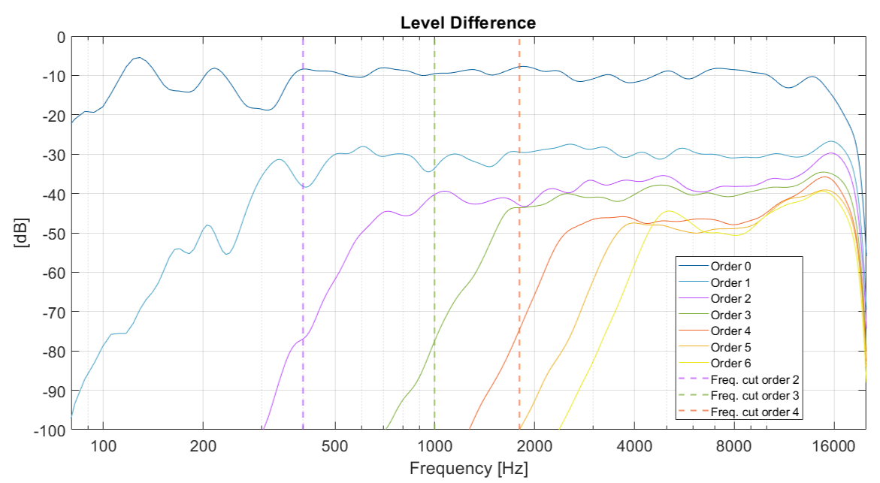
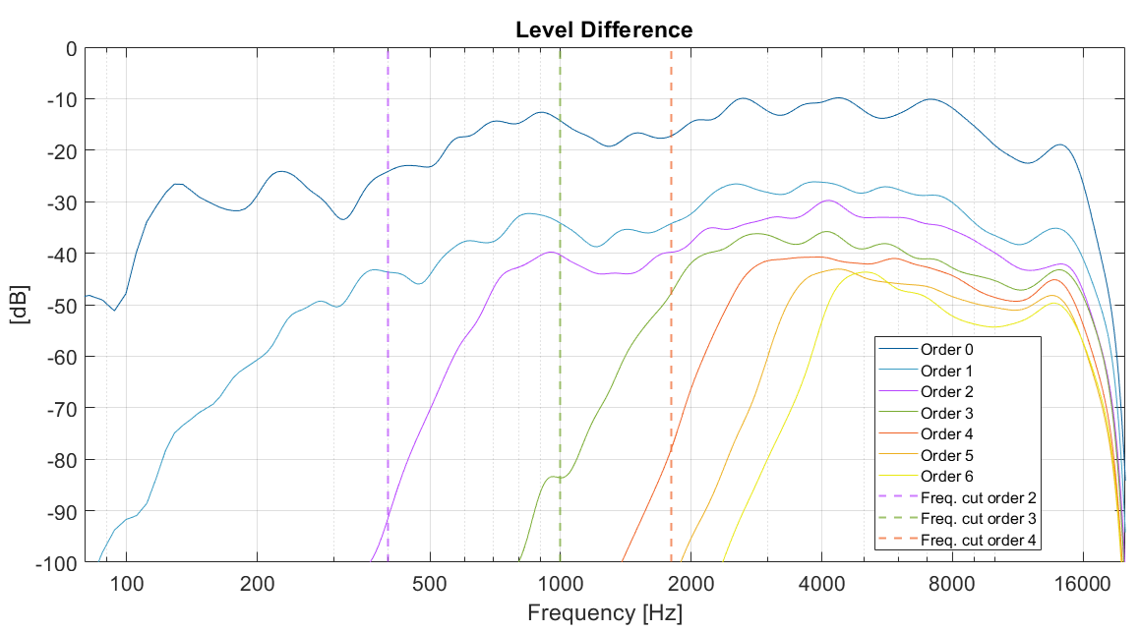
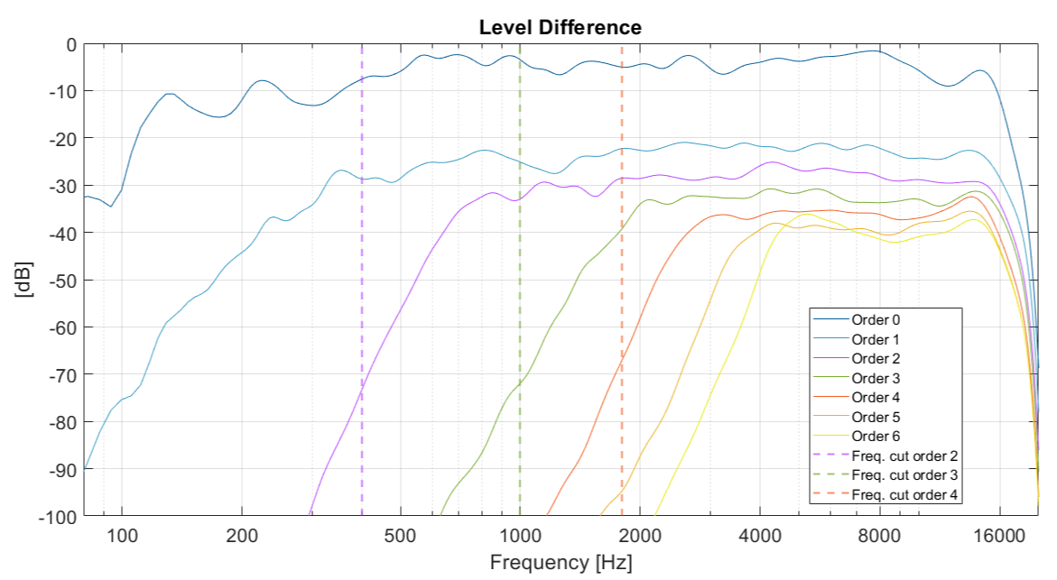
Not equalized
Equalized
Central
Left

Slide 16
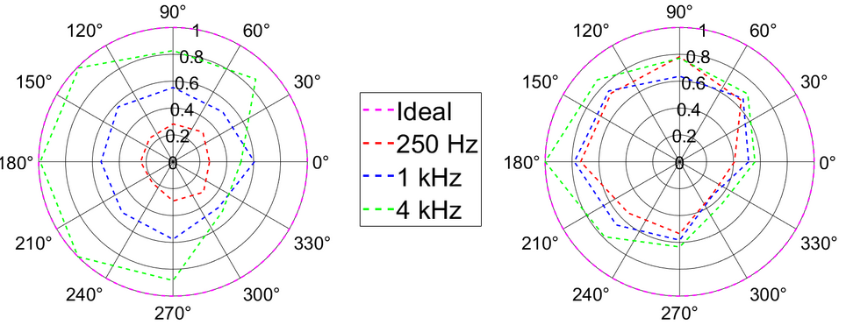
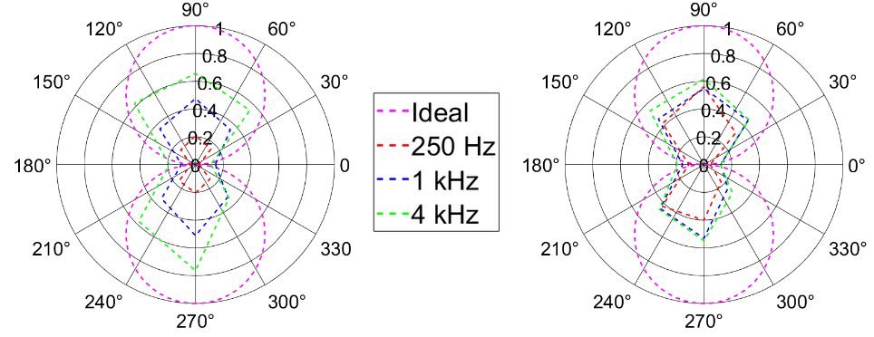
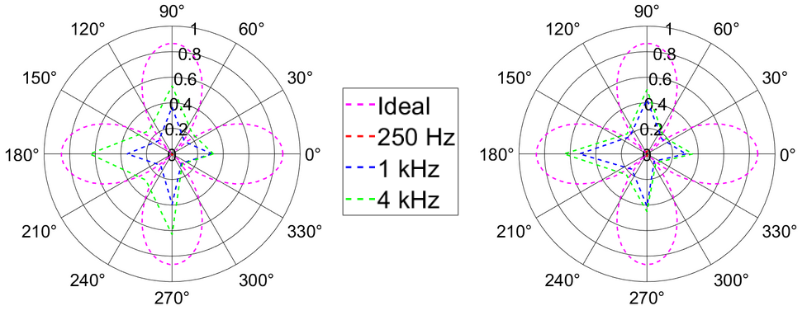
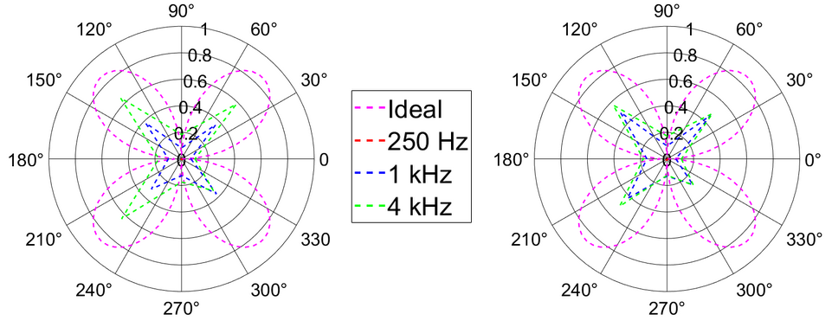
Spherical harmonics: polar plots rendering
Not equalized
Equalized
Not equalized
Equalized
Ŷ00
Ŷ1 -1
Ŷ2-2
Ŷ22

Slide 17
Outcomes and considerations
Excellent room sound absorption properties
Spatial Correlation and Level Difference much improved with equalisation
Performance enhanced in the central position than in the off-center position
The metrics behave as desired, proving that they can be used for the Ambisonics evaluation of audio reproduction

Slide 18
Limits and future developments
Metric for a comparison with respect to sources coming from ideal directions
Introduction of the decoding for a complete evaluation
Measure in a grid of positions
Extended to untreated acoustically domains
Incorporating the decoding enhancement
Taking into account the spatial distribution of the sources
Mapping of the quality in various listening points

Slide 19
Thank you for your attention
Sofia Parrinelli
Student ID: 991735

